Slide 1
Society is Too Dependent on SSRIs
Rachel Goldman & Kyle Kauffman

Slide 2
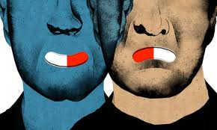
Disclaimer

Slide 3
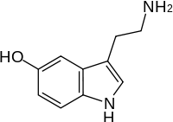
Science
The depressed brain has a smaller prefrontal cortex (Richter, 2012).
Helps scientists and medical personal to comprehend what depression is caused by and how it affects the brain (Richter, 2012).

Slide 4
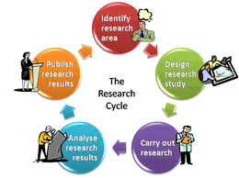
Technology
Learn effective ways for treating the brain and the prefrontal cortex which controls the people’s emotions (Diaz, 2011)
Will help lead to more improved treatments for depression and improve the quality of SSRIs (Gawley, 2007).

Slide 5
History
387 B.C. Plato had a theory that the brain is the main mechanism of mental processes. (“All Psych”, 2003)
Late 1960’s MAOIs (monoamine oxidase inhibitors), which were prescribed for depression, were taken off shelves due to major side effects, such as suicide. (Glenmullen, 2000)
1969 Zelmid by Astra. (Timeline, 2012)

Slide 6
SSRI
Selective Serotonin Reuptake Inhibitors (SSRI)
Can improve not only depression but anxiety and other mental illnesses (WebMD, 2012).
SSRIs are known for improving mood and behaviors of individuals that are struggling with depression. (WebMD, 2012)

Slide 7
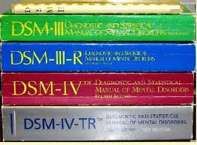
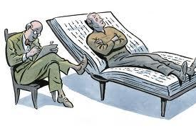
Depression

Slide 8
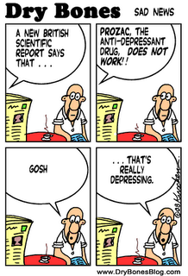
Depression: In Numbers
Over 18 million office visits a year
Over 100 million prescriptions a year
On the economic wallet
ONLY $44 billion a year!
“Clinical paradox”
Only 1 out of 3 patients are accurately diagnosed
(Vrana, 2006)

Slide 9
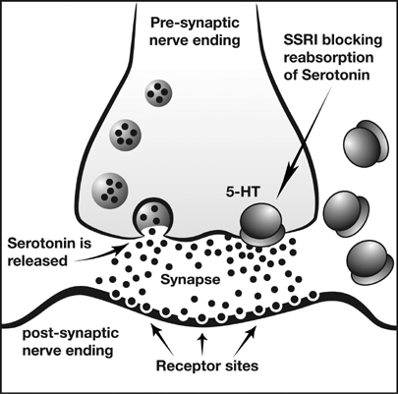
Video
How SSRIs Work
Notes:
http://www.dailymotion.com/video/x16jgq_how-anti-depressants-work_school

Slide 10
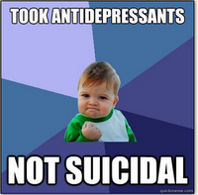
Side Effects
The side effects are different for each individual and are extremely lethal (WebMD, 2012).
Physical symptoms
Sexual effects
The most lethal of all, suicide. (Harvard Health, 2005).

Slide 11
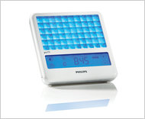
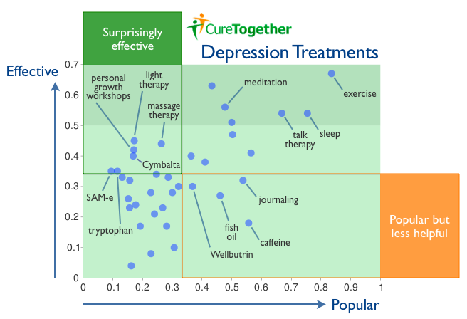
Other Treatments
Notes:
Dark chocolate helped cure depression.

Slide 12
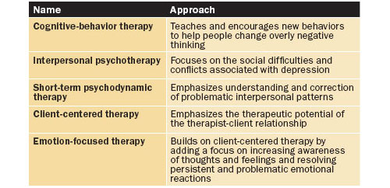
Therapies

Slide 13
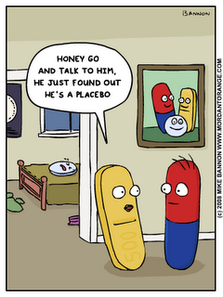
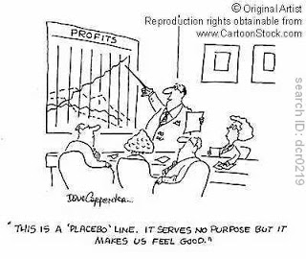
Placebo

Slide 14
“The Placebo Effect” Studies
Notes:
3:00 to 5:25
http://www.youtube.com/watch?v=Zihdr36WVi4

Slide 15
Government
Is the base of how SSRIs are prescribed and why they tend to be overly prescribed (NCHS, 2011).
The government had done a study to see which drug was the most prescribed in the United States, antidepressant was number one (NCHS, 2011).
“Prozac has internal documents, some dating to the mid-1980’s, as well as government applications and patents, indicate that the pharmaceutical giant has known for years that its best-selling drug (Prozac) could cause suicidal reactions in a small but significant number of patients” (Garnett, 2000).

Slide 16
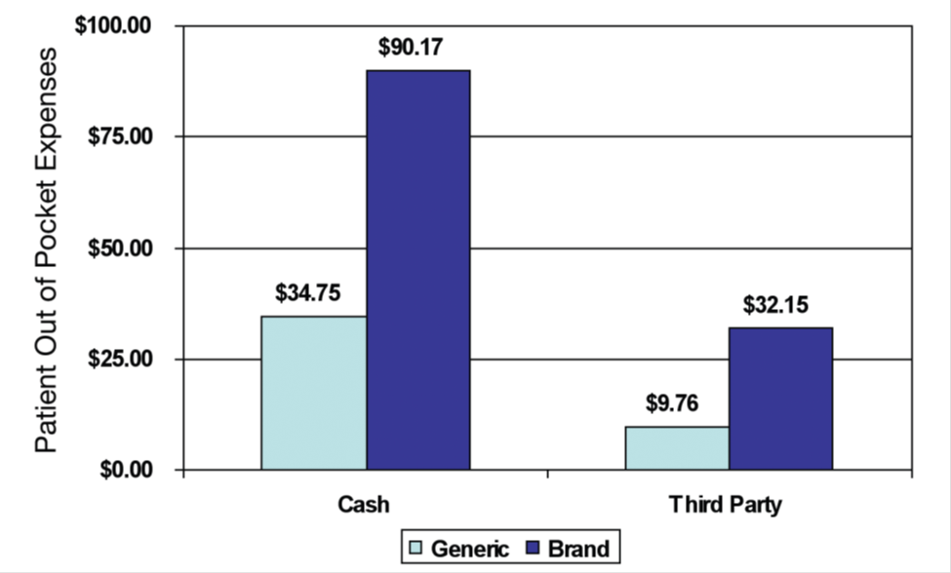
Insurance
Depression costs the US economy more than US$ 43 billion annually. (World Health Organization, 2007).
For having insurance, therapy can be as little as $25 for one session, for antidepressants it can be as little as $5, but it all depends on the insurance company the individual has (ADAA, 2012).
Therapy can cost $100 or more per hour, on the other hand antidepressants can cost around $50. (ADAA, 2012).

Slide 17
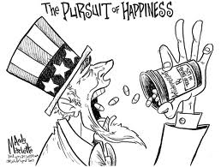
Lawsuit – Black Box
Under Pennsylvania law, a husband has sued manufacturers, designers, and distributors of antidepressant medication due to the death of his wife (Reuters, 2012).
She had committed suicide and there was allegedly no warning for suicidal thoughts, which goes against the black-box label that is supposed to be on every antidepressant (Reuters, 2012).

Slide 18
Lawsuit- Zoloft
“What if a person who is depressed eats a piece of pizza and gets an upset stomach, because it’s greasy and the individual out of nowhere says, that’s the last straw. I am committing suicide! Could the pizza be held responsible?” –Pfizer (Yeoman, 2007)

Slide 19
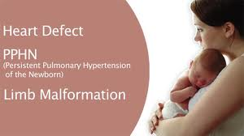
Lawsuit- Pregnancy
According to Domar, “cognitive behavioral therapy is just as effective and safer during pregnancy” (Weintraub, 2012)
Studies show that antidepressants used during pregnancy are linked to:
Miscarriage
Preterm birth
Rare heart defects and;
Behavioral problems
(Weintraub, 2012)

Slide 20
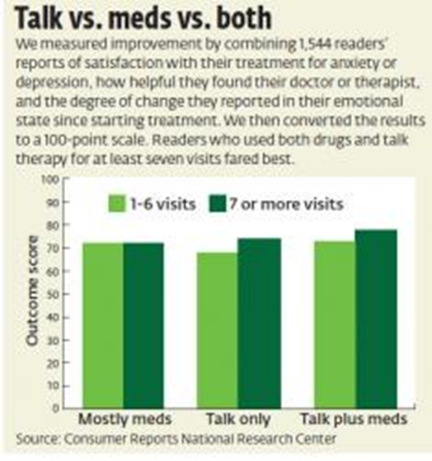
Future Implications

Slide 21
Work Cited
Antidepressants: Myths and facts about ssris. ( 2012). Retrieved from http://www.webmd.com/depression/ssris-myths-and-facts-about-antidepressants
Anxiety disorders association of america. (2010). Retrieved from http://www.adaa.org/finding-help/treatment/low-cost-treatment
Bate , R., &Calfee , J. World Health Organization, (2004). Pharmaceutical and the worldwide hivepidemic: can a stakeholder model work? Retrieved from Joint Center website:http://www.who.int/intellectualproperty/news/en/Submission-Calfee.pdf
Berger, F. K., & Zieve, D. (2011, March 15). Major depression. Retrieved from http://www.ncbi.nlm.nih.gov/pubmedhealth/PMH0001941/ (Berger & Zieve, 2011)
Brennan, B. (2008, April 16). What are the side effects associated with antidepressant treatment for anxiety disorder, and are there long-term risks?. ABC News. Retrieved from http://abcnews.go.com/Health/AnxietyTreating/story?id=4665296
Crockett MJ et al. Serotonin selectively influences moral judgment and behavior through effects on harm aversion. Proc Natl Acad Sci U S A 2010 Oct 5; 107:17433.
Currie , J. (2005, May ). The marketization of depression: Prescribing ssri antidepressants to women*. Retrieved from http://psychrights.org/articles/ssris.pdf
Depression diagnosis, depression disorder, treatment of depression. (2007, January 24). Retrieved from http://www.searo.who.int/en/section1174/section1199
Diaz, S., Doly, S., Narboux-Nême,, N., Fernandez, S., Mazot, P., Banas, S., Boutourlinsky, K., &Moutkine, I. (2011). 5-ht2b receptors are required for serotonin-selective antidepressant actions. US National Library of Medicine National Institutes of Health, 17(2), 154–163. . Retrieved from http://www.ncbi.nlm.nih.gov/pmc/articles
Dietz, L. (2012, August). Wrongful death. Retrieved from http://campus.westlaw.com.ezproxy.fgcu.edu/result/default.wl?cfid=1&mt=CampusLaw

Slide 22
Work Cited Continued
Mao, K. (2012, May 28). Anti-depressants (the religion of ssri) . Retrieved from http://churchofpossibility.com/2012/05/28/anti-depressants-the-religion-of-ssri/
Medicinenet.com . (n.d.). Retrieved from http://www.medicinenet.com/psychotherapy/article.htm
NIMH. (2011, July 27). www.nimh.nih.gov. Retrieved from http://www.nimh.nih.gov/health/publications/depression/what-is-depression.shtml
Putting Science in the Dock Barry Yeoman 2007 https://www.paxilprogress.org/forums/showthread.php?t=25859
Richter, R. (2012, Spring). Special report: Positive charge; new technology to treat depression. Retrieved from http://stanmed.stanford.edu/2012spring/article2.html
Silver, J. (2010, November). Can ssris affect morality?. Retrieved from http://psychiatry.jwatch.org/cgi/content/full/2010/1108/2
Ssri side effects: Harvard mental health letter discusses the real risks of antidepressants. (2005, May). Retrieved from http://www.health.harvard.edu/press_releases/ssri_side_effects ("Ssri side effects:," 2005)
Wade , A., Johnson , P., & McConnachie , A. (26, November 2010). Antidepressant treatment and cultural differences - a survey of the attitudes of physicians and patients in sweden and turkey. Retrieved from http://www.biomedcentral.com/1471-2296/11/93
Yeoman , B. (2004). Putting science in the dock. Retrieved from https://www.paxilprogress.org/forums/showthread.php?t=25859

